Slide 1
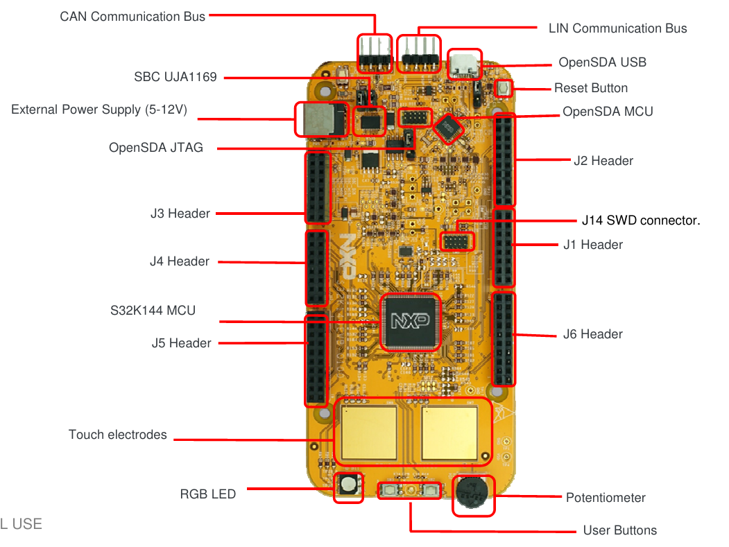

Slide 2
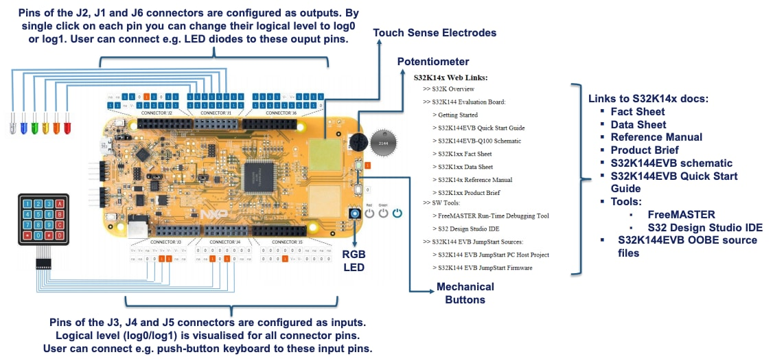

Slide 3
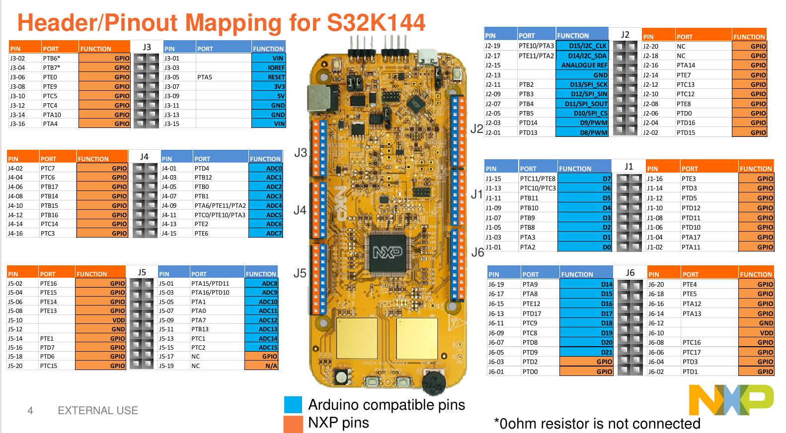

Slide 4
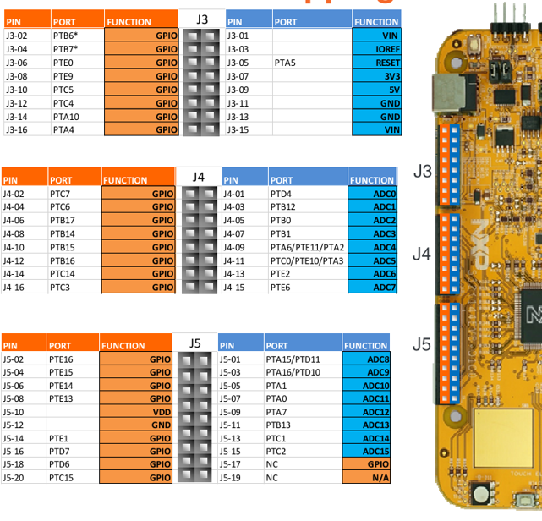
주요 핀
VDD : J3-07(3V3), J3-09(5V), J5-10
GND : J3-11, J3-13, J5-12
ADC : J4-01, 03, 05, 07, 09, 11, 13, 15 J5-01, 03, 05, 07, 09, 11, 13, 15
RESET :
GPIO : J3-02, 04, 06, 08, 10, 12, 14, 16 J4-02, 04, 06, 08, 10, 12, 14, 16 J5-02, 04, 06, 08, 10, 12, 14, 16 ,18, 20
IOREF : J3-03

Slide 5
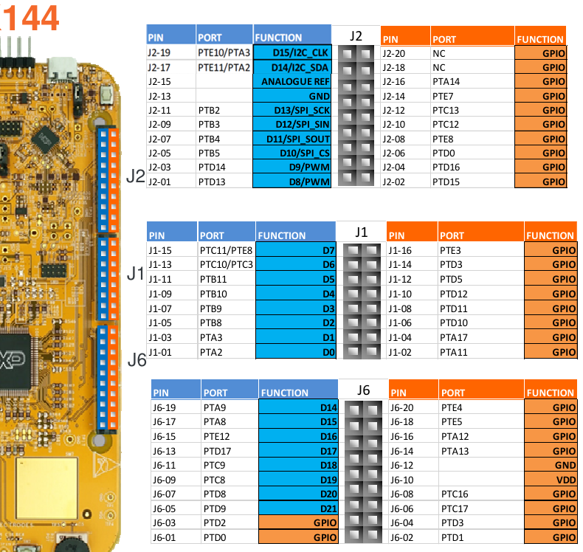
주요 핀
I2C
I2C_CLK : J2-19
I2C_SDA : J2-17
아날로그 레퍼런스? : J2-15
SPI
SPI_SCK : J2-11
SPI_SIN : J2-09
SPI_SOUT : J2-07
SPI_CS : J2-05
PWM : J2-03, J2-01
GPIO : J2-02, 04, 06, 08, 10, 12, 14, 16, 18, 20 J1-02, 04, 06, 08, 10, 12, 14, 16, 18, 20 J6-01,02,03,04,06,08,10,12,14,16,18,20
D? : J1-01, 03, 05, 07, 09, 11, 13, 15 J6-05, 07, 09, 11, 13, 15, 17, 19 J2-01, 03, 05, 07, 09, 11, 17, 19
GND : J2-13

Slide 6
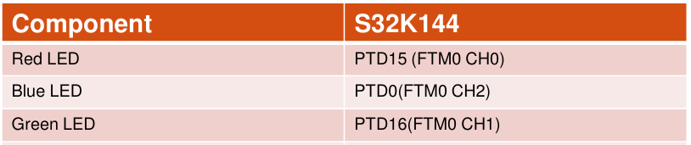
HMI - LED

Slide 7
HMI – 가변저항 (Potentiometer)

Slide 8
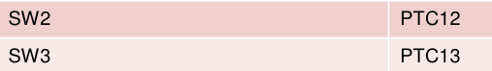
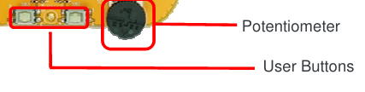
HMI – SW(스위치)

Slide 9

HMI – OpenSDA UART

Slide 10
HMI – CAN 인터페이스

Slide 11
HMI – LIN 인터페이스

Slide 12
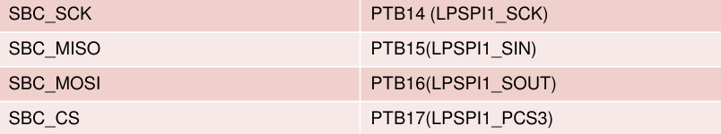
HMI – SBC SCK : Serial Clock MISO : Master In / Slave Out MOSI : Master Out / Slave In CS : Chip Set

